Slide 1
Hop To IT!
Conclusions

Slide 3
Accomodate

Slide 4
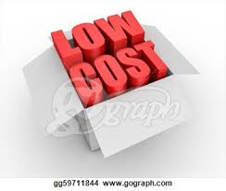
Modest Amount

Slide 5
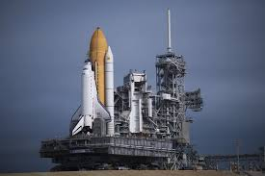
Launching Pad

Slide 6
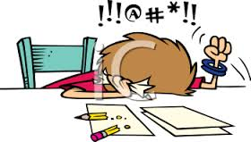
Frustrated

Slide 7
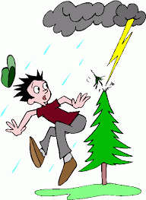
Unpredictable

Slide 8
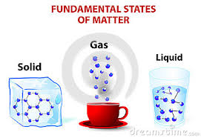
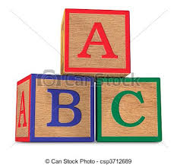
Fundamental

Slide 9
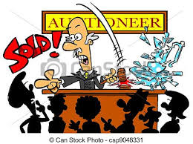
Auction

Slide 10
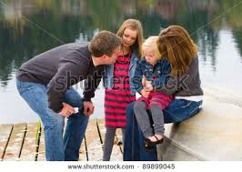
They are consoling the little girl
Consolation

