Slide 1
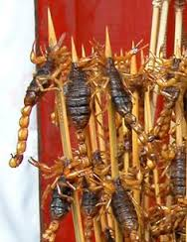
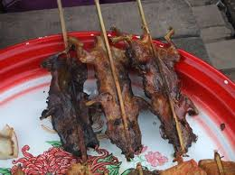
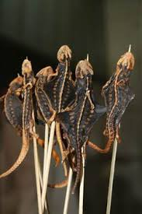
Ch4: Bugs, Rats and other Tasty Dishes

Slide 2
Delicacy

Slide 3
Alive

Slide 4
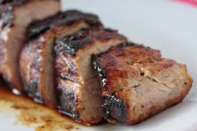
Pork

Slide 5
Grill

Slide 6
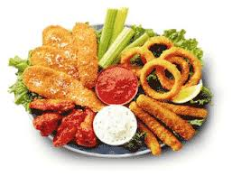
Appetizer

Slide 7
Native

Slide 8
Dessert

Slide 9
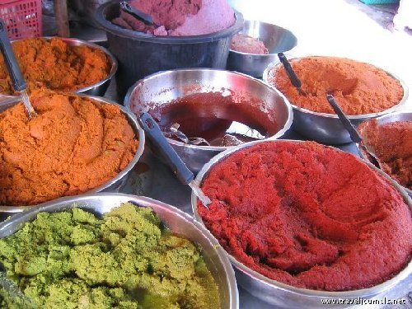
Paste

