Slide 1
Thanksgiving – Hawaiian Style
Essay Outlines

Slide 2
Paste

Slide 3
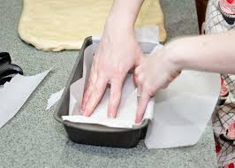
Line the pan

Slide 4
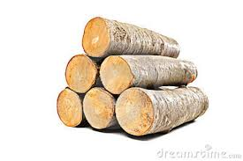
Pile

Slide 5
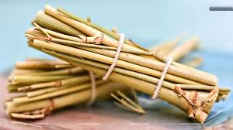
bundles

Slide 6
Shoveled

Slide 7
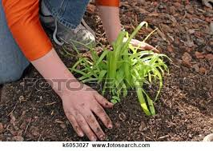
Pat

Slide 8
Not a Trace

Slide 9
Emerge

