Slide 1
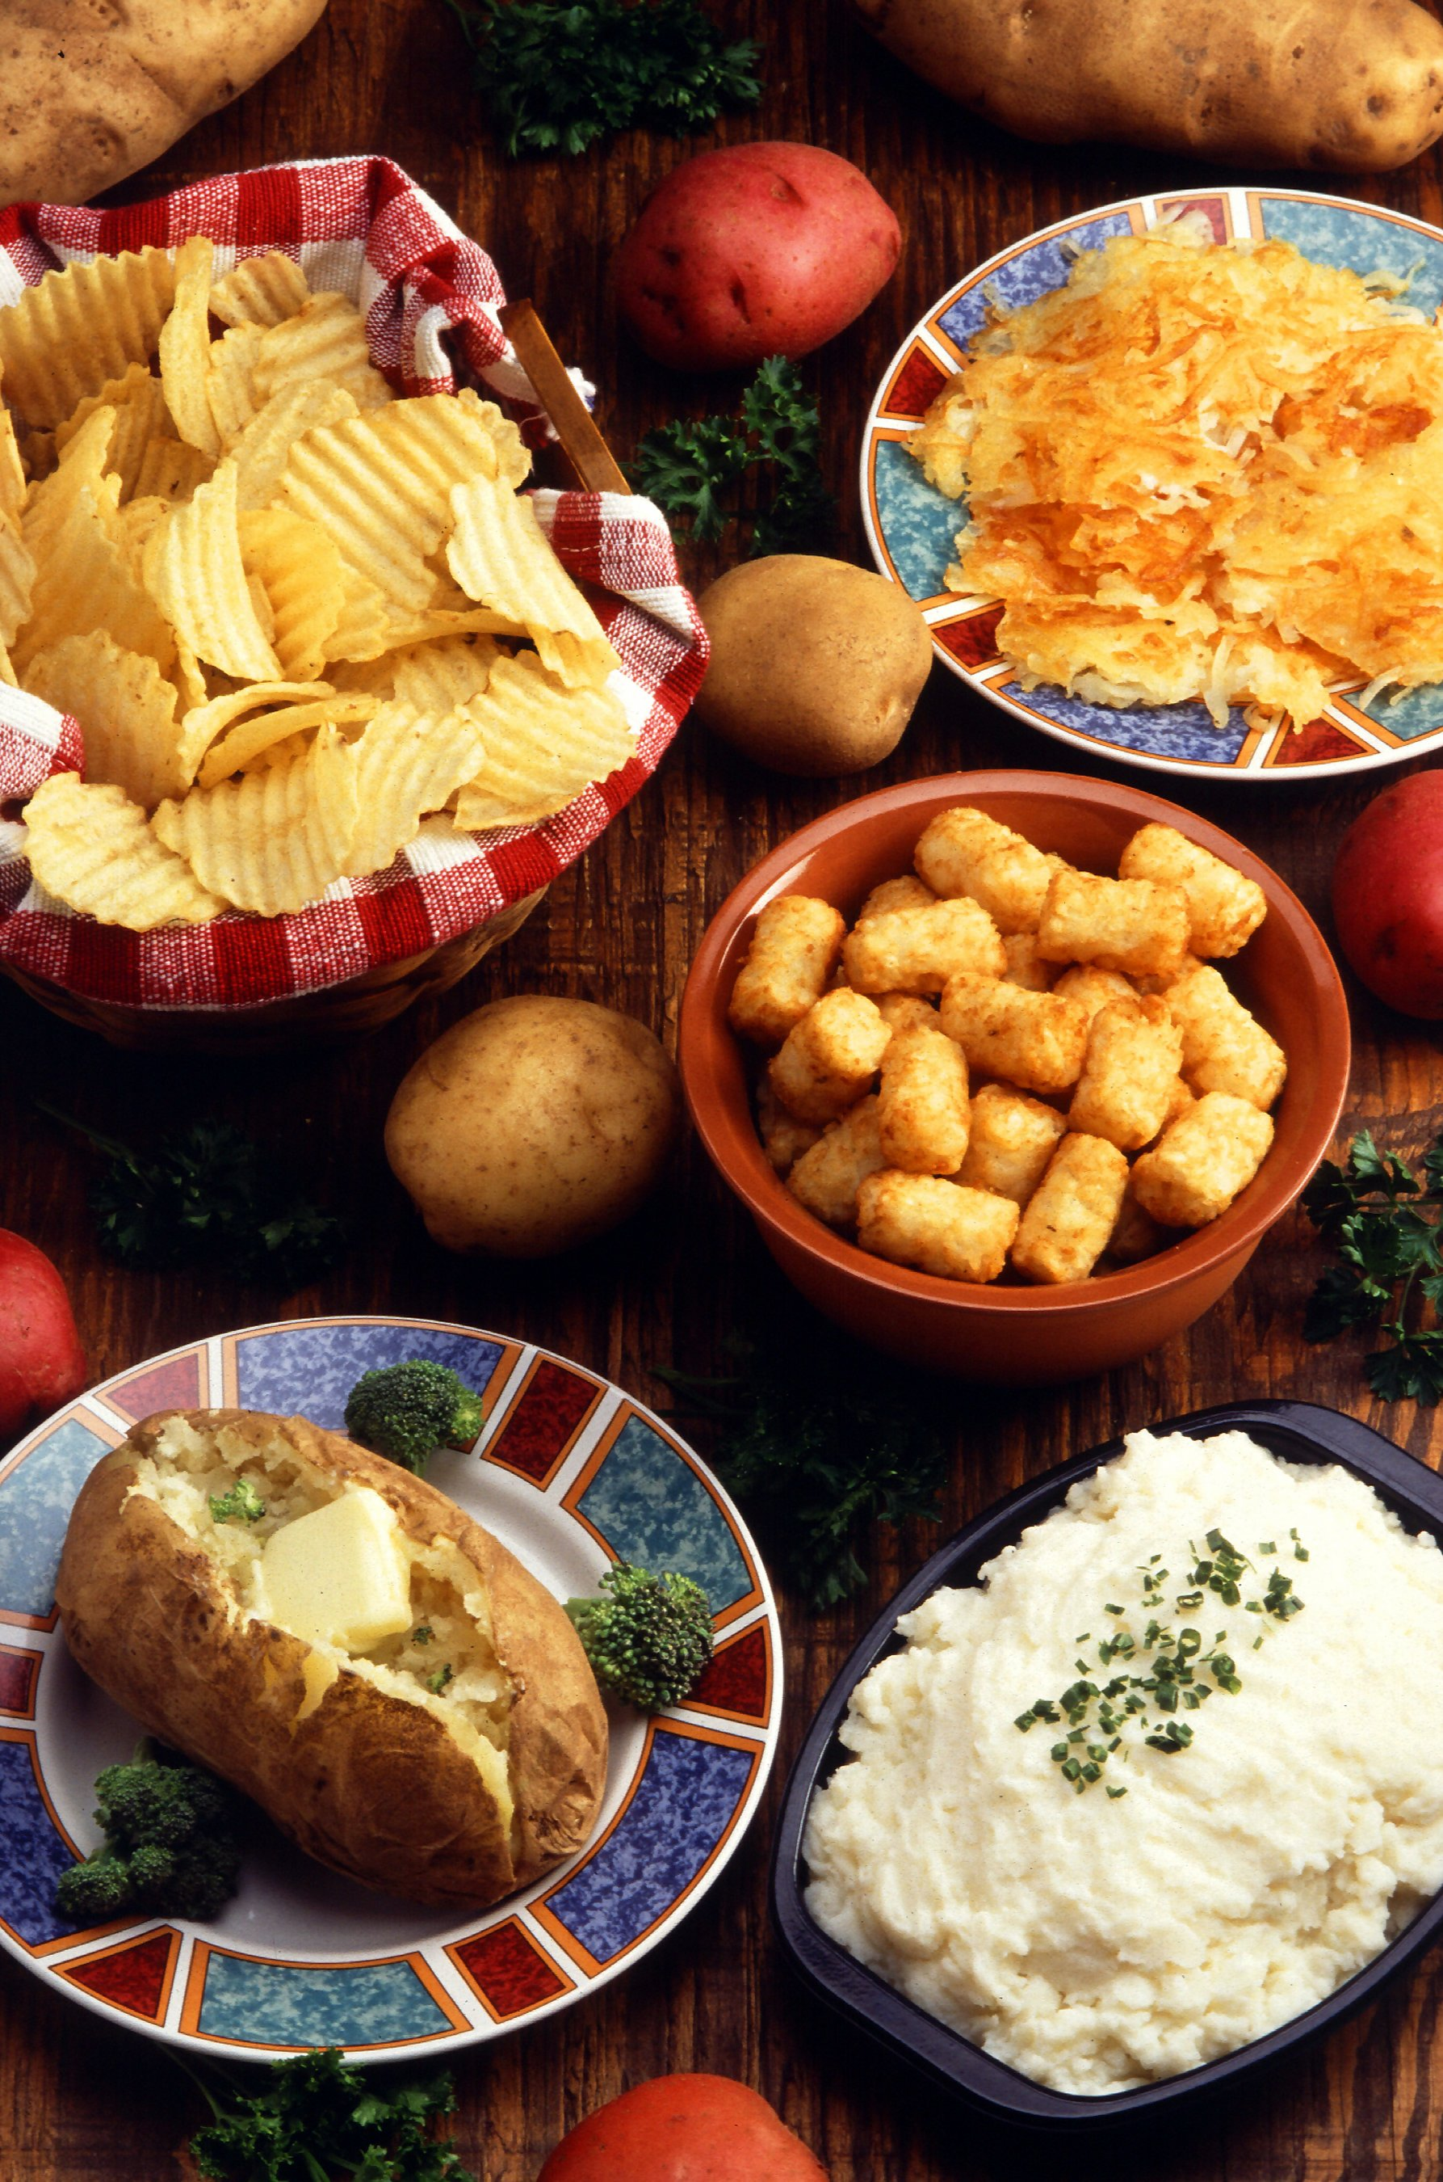
Ch. 3: Eat Potatoes

Slide 2
Imagine

Slide 3
Poison

Slide 4
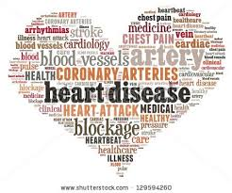
Disease

Slide 5
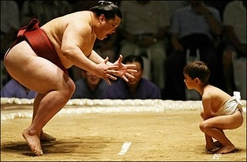
Advantage

Slide 6
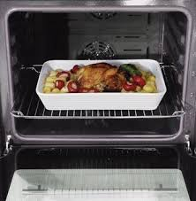
Baked

Slide 7
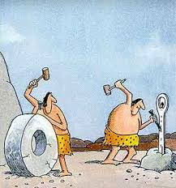
Invented

Slide 8
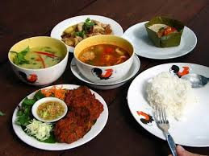
Dishes/Cooked Foods

