Slide 1
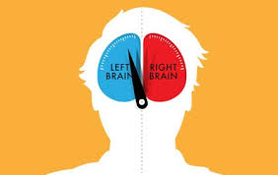
Ch. 1: Right Brain/Left Brain
Paragraph Structure
Capitalization

Slide 2
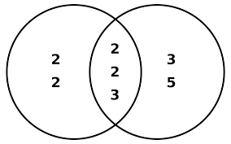
In Common

Slide 3
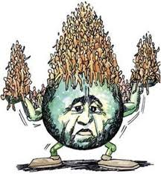
Population

Slide 4
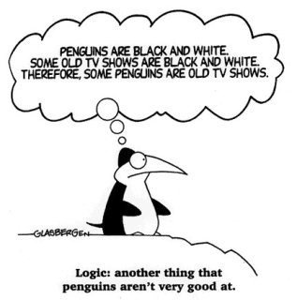

Slide 5
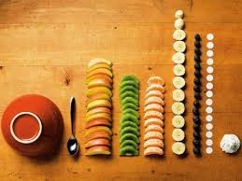
In Order

Slide 6
Out of Order

Slide 7
Punctual

Slide 8
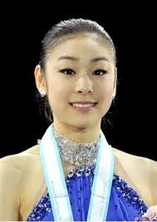
Recognize Someone
= To know who someone is

Slide 9
Rule: I before E: Believe, Eight, Friend
except after C : Perceive, Ceiling, Receive
Exceptions

