Slide 1
Pets TO THE RESCUE…
-Such as…

Slide 2
Significantly
She was significantly better after practicing

Slide 3
Overall/generally/usually
Overall students who come to writing learn the writing material better.

Slide 4
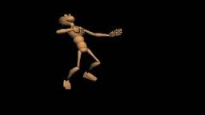
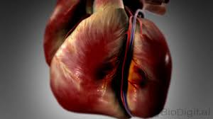
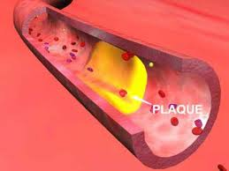
Heart Attack

Slide 5
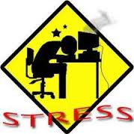
Cope with
She copes with stress
by meditating…

Slide 6
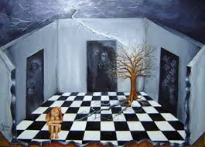
Emotionally Disturbed

Slide 7
Do Wonders/Benifits

Slide 8
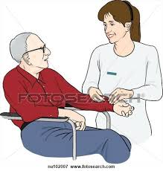
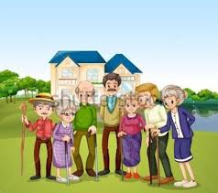
Nursing Homes

Slide 9
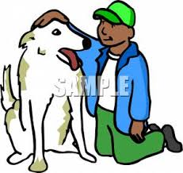
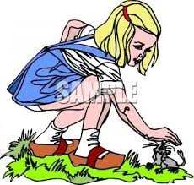
To pet

Slide 10
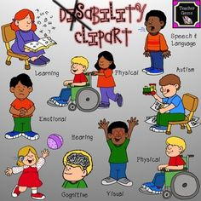
Special Needs

