Slide 1
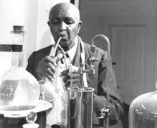
George Washington Carver
-Using Description with a narrative

Slide 2
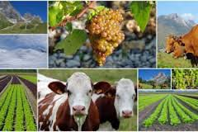
Field(study) of Agriculture
Races or large groups of people who have the
same customs, religion, or origin

Slide 3
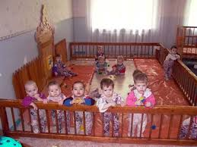
ORPHANS

Slide 4
Admit

Slide 5
Support Himself
Thick body

Slide 6
Outstanding Yes No

Slide 7
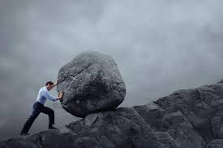
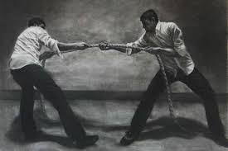
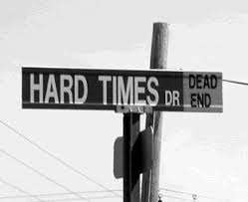
Struggling

Slide 8
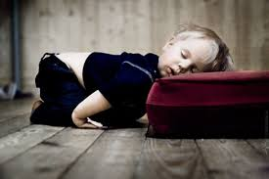
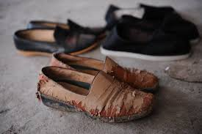
Wore out

Slide 9
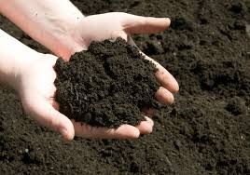
Soil
There is no money to speak of in my pockets

Slide 10
Generous Offer

Slide 11
Provide (Give) opprtunities (Chances)

