Slide 1
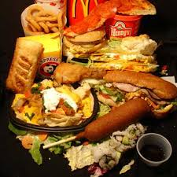
A Taste of America
-Compare and Contrast

Slide 2
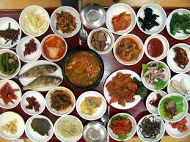
Korean Cuisine

Slide 3
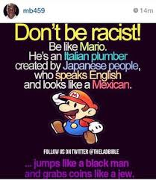
Diverse
Races or large groups of people who have the
same customs, religion, or origin

Slide 4
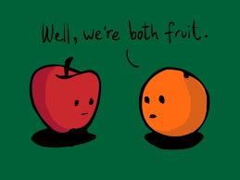
In Regard To/Compared To

Slide 5
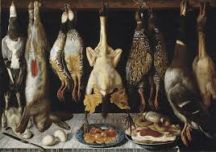
Game

Slide 6
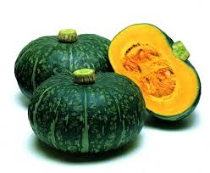
Squash
Thick body

Slide 7
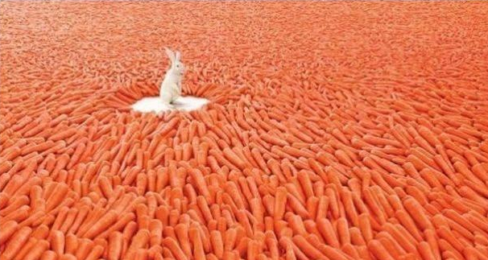
Abundant

Slide 8
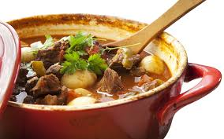
Stews

Slide 9
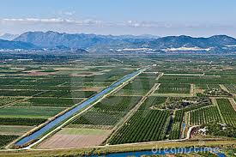
Fertile Land

Slide 10
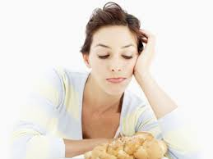
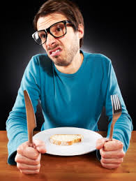
Bland/Boring Food
There is no money to speak of in my pockets

Slide 11
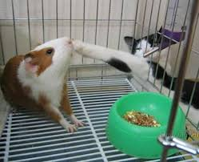
Practically/Almost

